Slide 1
PROCESSING
INSTRUCTION
LECTURE 6

Slide 2
WHAT IS A PROGRAM?
A sequence of steps
For each step, an arithmetic or logical operation is done
For each operation, a different set of control signals is needed

Slide 3
COMPONENTS
The Control Unit and the Arithmetic and Logic Unit constitute the Central Processing Unit
Data and instructions need to get into the system and results out
  Input/output
Temporary storage of code and results is needed
  Main memory

Slide 4
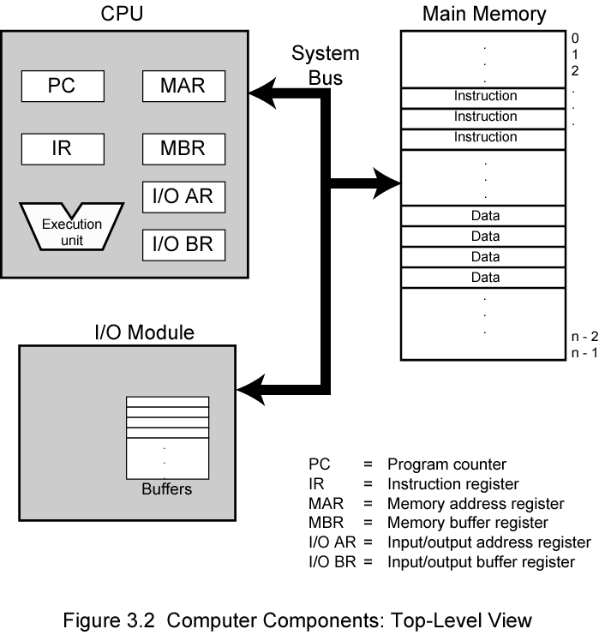
COMPUTER COMPONENTS:
TOP LEVEL VIEW

Slide 5
REGISTER:
Program Counter: It contains the address of next instruction
to be executed
Instruction Register: It holds the instruction
Memory Address Register: Hold the address of location to or from data is to be transferred
Memory Buffer Register: It contains data to be written in to or read out of address location
I/O Register: It specifies the particular I/O device
I/O Buffer Register: Used for exchange of data b/w Input/ Output module & CPU.
Accumulator:Temporary hold the operand and results of ALU operations

Slide 6

INSTRUCTION CYCLE
Processing required for Instruction is called Instruction Cycle.
Two steps:
  Fetch:
  Execute

Slide 7
FETCH CYCLE
Program Counter (PC) holds address of next instruction to fetch
Processor fetches instruction from memory location pointed to by PC
Increment PC
  Unless told otherwise
Instruction loaded into Instruction Register (IR)
Processor interprets instruction and performs required actions

Slide 8
EXECUTE CYCLE
Processor-memory
  data transfer between CPU and main memory
Processor- I/O
  Data transfer between CPU and I/O module
Data processing
  Some arithmetic or logical operation on data
Control
  Alteration of sequence of operations
  e.g. jump
  Processor fetches an instruction from location 149 which specifies next instruction from location 182 thus on next fetch cycle , instruction will be fetched from location 18

Slide 9
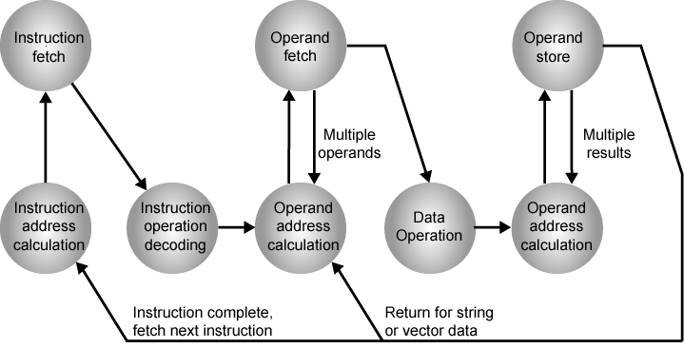
INSTRUCTION CYCLE STATE DIAGRAM

Slide 10
EXPLANATION
Instruction Address Calculator: Determines the address of next instruction to be executed.
Instruction Operating Decoding : Analyze instruction to determine type of operation to be performed and operand (if any) to be used.
Instruction Fetch: Read instruction from its memory location to CPU.
Operand Address Calculator: If the operation involves to an operand in memory or through peripherals then determines the address of operands.
Operand Fetch: Fetches the operand from memory & input device.
Data Operations :Perform the operation as indicated in the instruction.
Operand Stores: Write the result in memory or Output device.

Slide 11
INTERRUPTS
Mechanism by which other modules (e.g. I/O) may interrupt normal sequence of processing
Interrupts are provided to improve the processing efficiency.

Slide 12
CLASSES OF INTERRUPTS :
Program: Generated by some condition that occurs as a result of an instruction execution such as
  e.g. overflow, division by zero , illegal machine instruction etc
Timer
  Generated by internal processor timer
  Used in pre-emptive multi-tasking
I/O
  Generated by an I/O controller
  To signal normal completion of an operation or to signal a variety of error conditions.
Hardware failure:
Generated by a Power failure or memory parity error

Slide 13
INTERRUPT CYCLE
1. Added to instruction cycle
2. Processor checks for interrupt
  Indicated by an interrupt signal
3. If no interrupt, fetch next instruction
4. If interrupt pending:
  Suspend execution of current program
  Save context
  Set PC to start address of interrupt handler routine
  Process interrupt
  Restore context and continue interrupted program

Slide 14

TRANSFER OF CONTROL VIA INTERRUPTS

Slide 15

INSTRUCTION CYCLE WITH INTERRUPTS

Slide 16
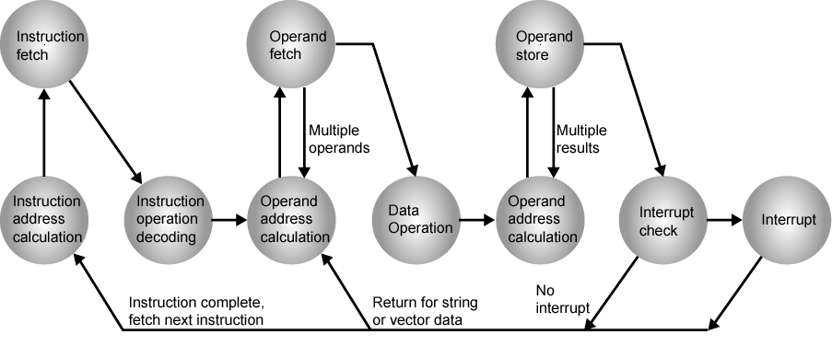
INSTRUCTION CYCLE (WITH INTERRUPTS) - STATE DIAGRAM

Slide 17
MULTIPLE INTERRUPTS
Disable interrupts
  Processor will ignore further interrupts whilst processing one interrupt
  Interrupts remain pending and are checked after first interrupt has been processed
  Interrupts handled in sequence as they occur
Define priorities
  Low priority interrupts can be interrupted by higher priority interrupts
  When higher priority interrupt has been processed, processor returns to previous interrupt

Slide 18

MULTIPLE INTERRUPTS - SEQUENTIAL

Slide 19
MULTIPLE INTERRUPTS – NESTED

Slide 20

TIME SEQUENCE OF MULTIPLE INTERRUPTS

